Slide 1

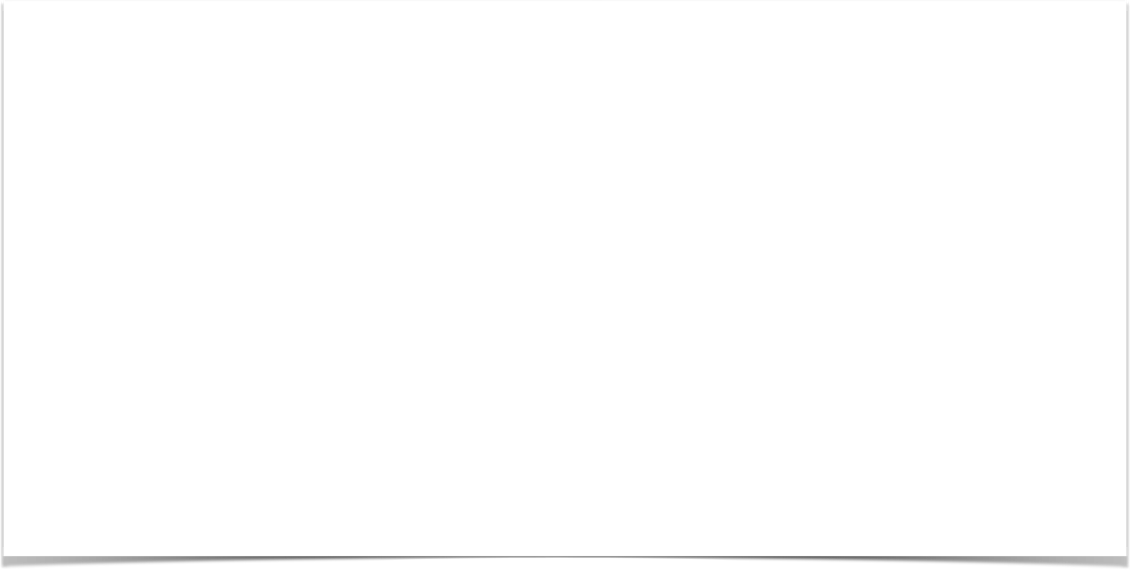

Spring MVC Form Validation

Slide 2
The Need for Validation
Check the user input form for
required fields valid numbers in a range valid format (postal code)
custom business rule
www.luv2code.com

Slide 3
Java’s Standard Bean Validation API
•
Java has a standard Bean Validation API
•
Defines a metadata model and API for entity validation
•
Not tied to either the web tier or the persistence tier
•
Available for server-side apps and also client-side JavaFX/Swing apps
http://www.beanvalidation.org
www.luv2code.com

Slide 4
Spring and Validation
•
Spring version 4 and higher supports Bean Validation API
•
Preferred method for validation when building Spring apps
•
Simply add Validation JARs to our project
www.luv2code.com

Slide 5





Bean Validation Features
Validation Feature
required
validate length
validate numbers
validate with regular expressions
custom validation
www.luv2code.com

Slide 6









Validation Annotations
Annotation Description
@NotNull | Checks that the annotated value is not null
@Min | Must be a number >= value
@Max | Must be a number <= value
@Size | Size must match the given size
@Pattern | Must match a regular expression pattern
@Future / @Past | Date must be in future or past of given date
others …
www.luv2code.com

Slide 7
Our Road Map
set up our development environment
required field
validate number range: min, max
validate using regular expression (regexp)
custom validation
www.luv2code.com

Slide 8


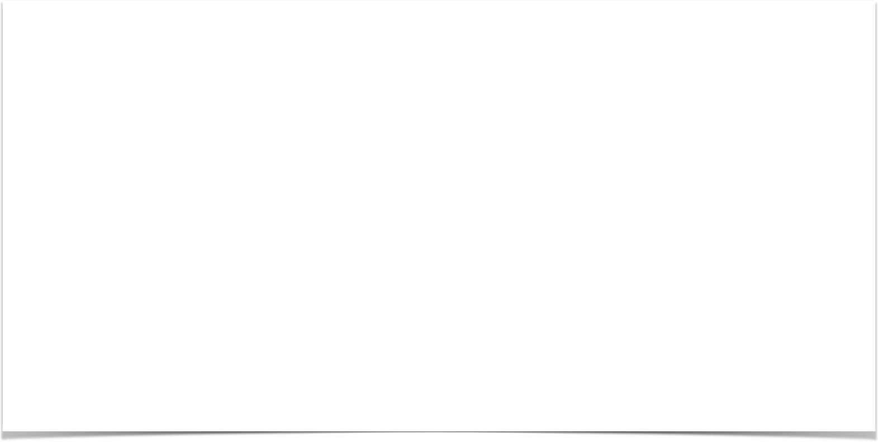

Setting Up Development Environment

Slide 9

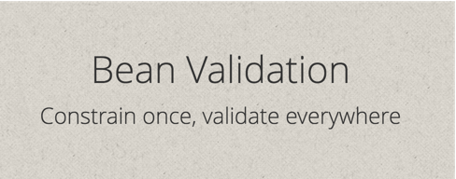
Java’s Standard Bean Validation API
•
Java’s standard Bean Validation API (JSR-303)
•
Only a specification … vendor independent … portable
•
BUT we still need an implementation …
www.luv2code.com

Slide 10
The Hibernate Team to the rescue!
•
Hibernate started as an ORM project
•
But in recent years, they have expanded into other areas
•
They have a fully compliant JSR-303 implementation
•
Not tied to ORM or database work … separate project
www.luv2code.com

Slide 11
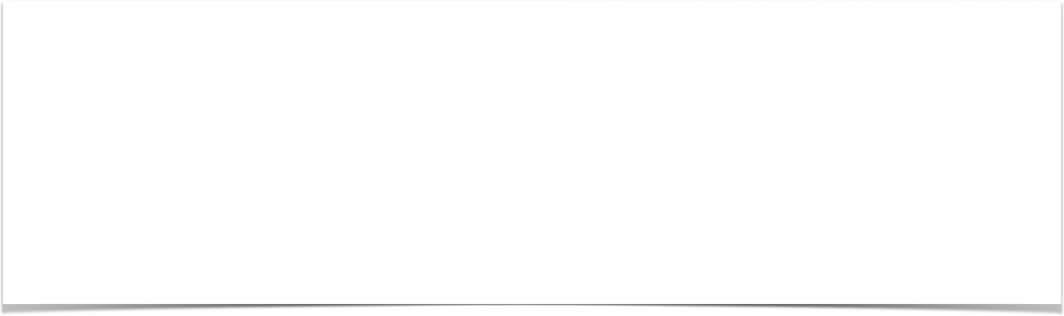
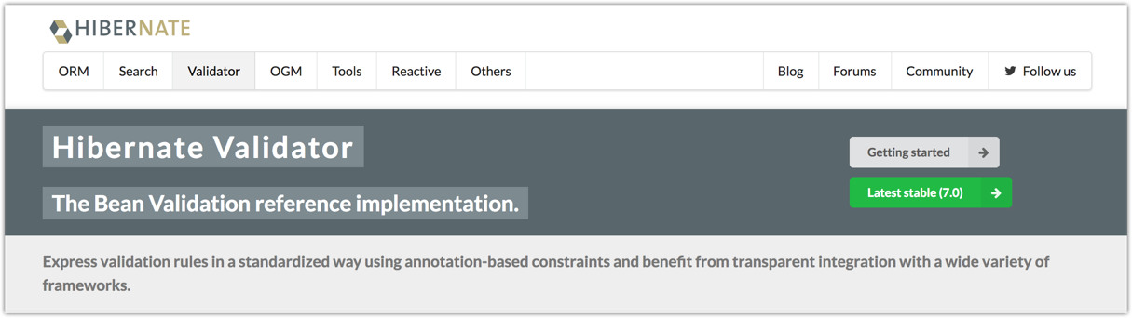
http://www.hibernate.org/validator
www.luv2code.com

Slide 12

About the Versions ... tricky!
Servlets JSP JDBC
Enterprise Java Beans
Java Message Service
...
•
Hibernate Validator 7 is based on Jakarta EE 9
https://javaee.github.io/javaee-spec
•
Jakarta EE is the community version of Java EE (rebranded, relicensed)
•
Allows innovation of Jakarta EE with community-driven approach
•
Jakarta EE does not replace Java EE
Last version is Java EE 8 (August 2017)
Jakarta EE is moving forward with Jakarta EE 9 (December 2020) and future releases
www.luv2code.com

Slide 13
Jakarta EE
At the moment, main change with Jakarta EE .... package renaming
•
javax.* packages are renamed to jakarta.*
•
For example
•
javax.servlet.http.HttpServlet is now jakarta.servlet.http.HttpServlet
https://jakarta.ee/about
www.luv2code.com

Slide 14
Okay ... what impact on Hibernate Validator??
Hibernate Validator 7 is based on Jakarta EE 9
•
Spring 5 is still based on some components of Java EE (javax.*)
•
Spring may use Jakarta EE components in the future ... but no news yet
•
As a result, Spring 5 is not compatible with Hibernate Validator 7
www.luv2code.com

Slide 15
But wait ... I need to use latest version!!!
Two releases of Hibernate Validator
Hibernate Validator 7 is for Jakarta EE 9 projects
Hibernate Validator 6.2 is compatible with Spring 5
•
Hibernate Validator 6.2 has the SAME features as Hibernate Validator 7
So you are not being left behind by using Hibernate Validator 6.2
Just tricky things with version numbers
www.luv2code.com

Slide 16
In Summary
If you are using Spring 5 .... then use Hibernate Validator 6.x
•
If you are using Jakarta EE 9 ... then use Hibernate Validator 7.x
•
Remember
•
Hibernate Validator 6.2 has the SAME features as Hibernate Validator 7
www.luv2code.com

Slide 17
More details on Hibernate Validator release
https://in.relation.to/hibernate-validator
www.luv2code.com

Slide 18
Development Process
Step-By-Step
Download Validation JAR files from Hibernate Validator website
Add JAR files to project
www.luv2code.com

Slide 19
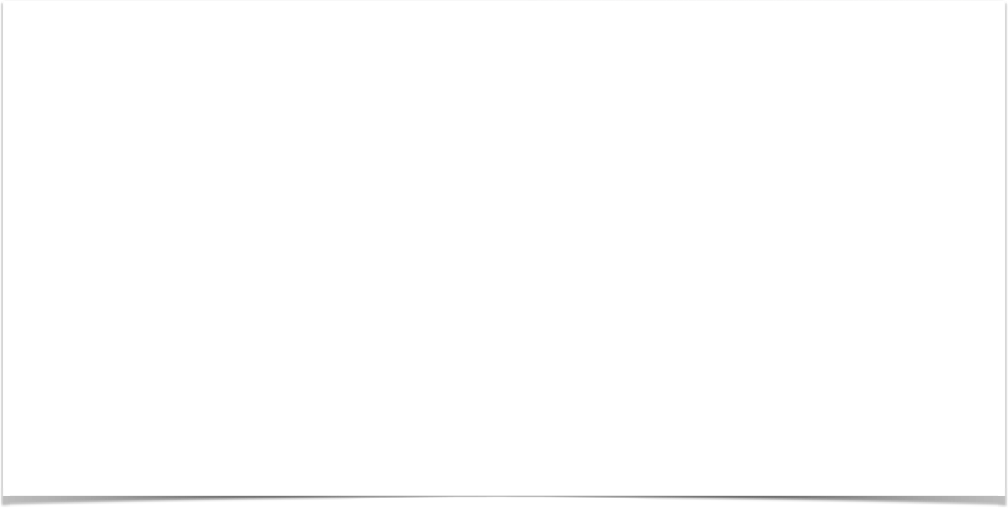
Spring MVC Form Validation Required Fields

Slide 20
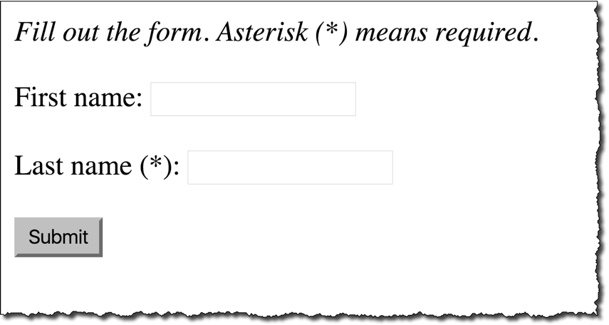
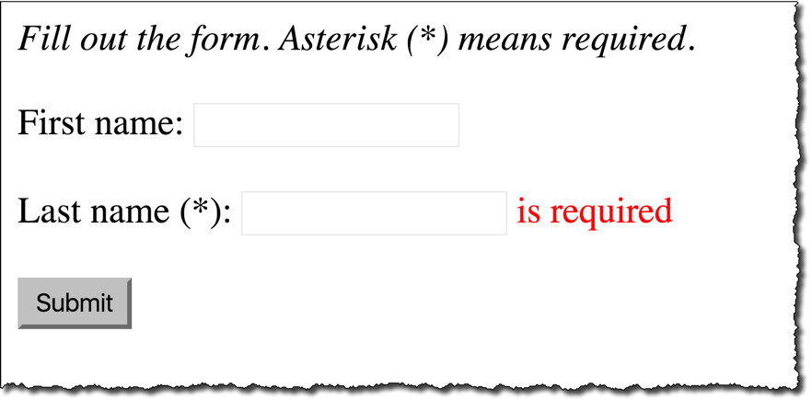

Required Fields
www.luv2code.com

Slide 21


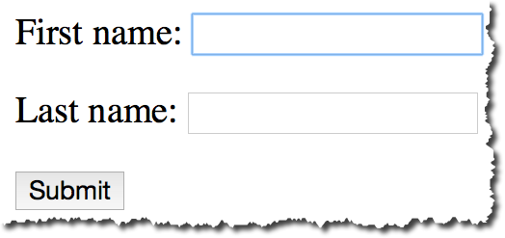


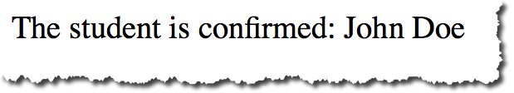
Pulling It All Together
customer-form.jsp
Customer
Customer Controller
Customer
customer-confirmation.jsp
www.luv2code.com

Slide 22
Development Process
Step-By-Step
Add validation rule to Customer class
Display error messages on HTML form
Perform validation in the Controller class
Update confirmation page
www.luv2code.com

Slide 23
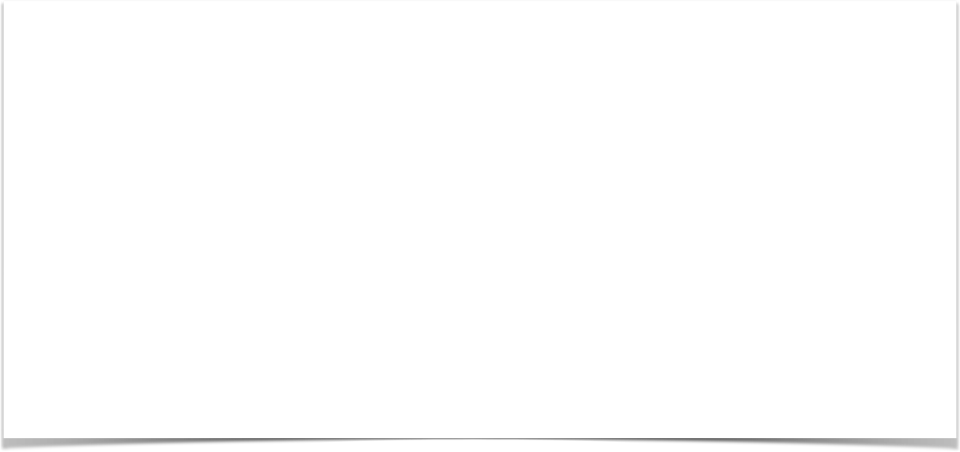
Step 1: Add validation rule to Customer class
import javax.validation.constraints.NotNull; import javax.validation.constraints.Size;
public class Customer {
private String firstName;
@NotNull(message="is required") @Size(min=1, message="is required") private String lastName;
// getter/setter methods
}
www.luv2code.com

Slide 24
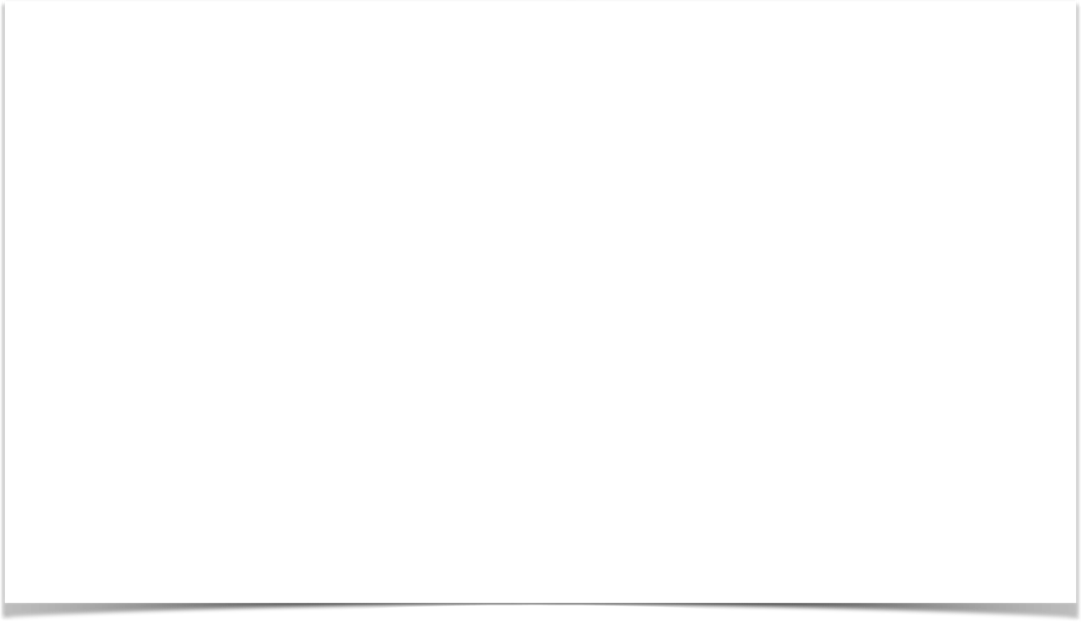
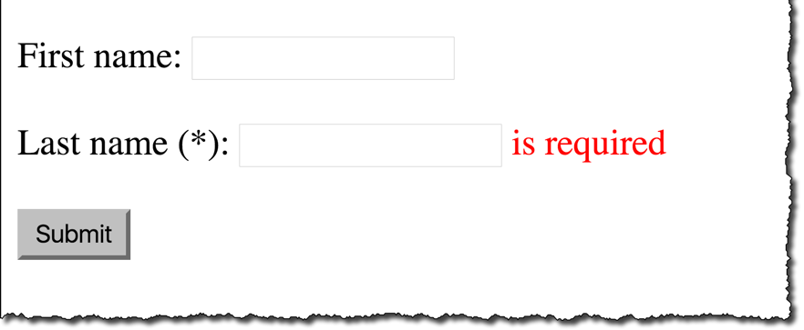
Step 2: Display error message on HTML form
customer-form.jsp
<form:form action="processForm" modelAttribute="customer"> First name: <form:input path="firstName" />
<br><br>
Last name (*): <form:input path="lastName" />
<form:errors path="lastName" cssClass="error" />
<br><br>
<input type="submit" value="Submit" />
</form:form>
www.luv2code.com

Slide 25
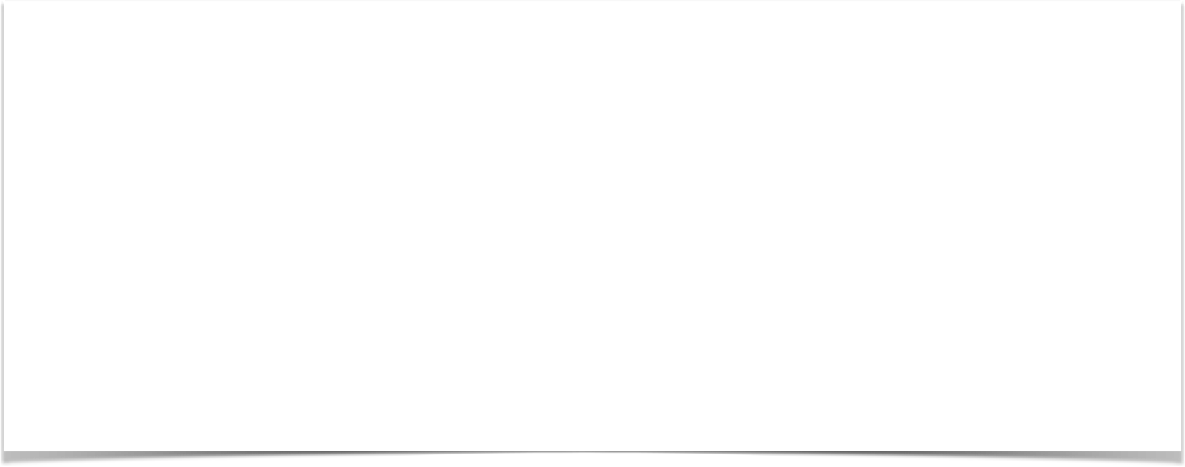

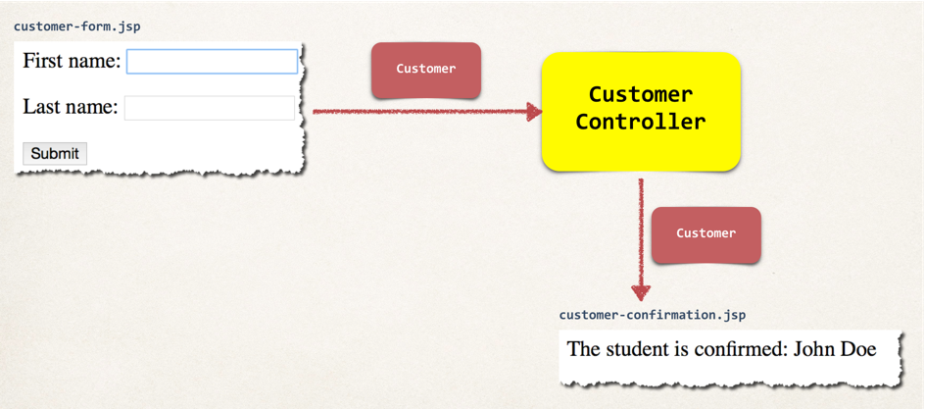
Step 3: Perform validation in Controller class
@RequestMapping("/processForm") public String processForm(
@Valid @ModelAttribute("customer") Customer theCustomer, BindingResult theBindingResult) {
if (theBindingResult.hasErrors()) { return "customer-form";
}
else {
return "customer-confirmation";
}
}
www.luv2code.com

Slide 26

Step 4: Update confirmation page
<html>
<body>
The customer is confirmed: ${customer.firstName} ${customer.lastName}
</body>
</html>
www.luv2code.com

